Slide 1
Bank Security
Staring At Clouds
Securing the Bank’s Cloud estate with Wiz.io
CyberCon 2023
Vince King

Slide 2
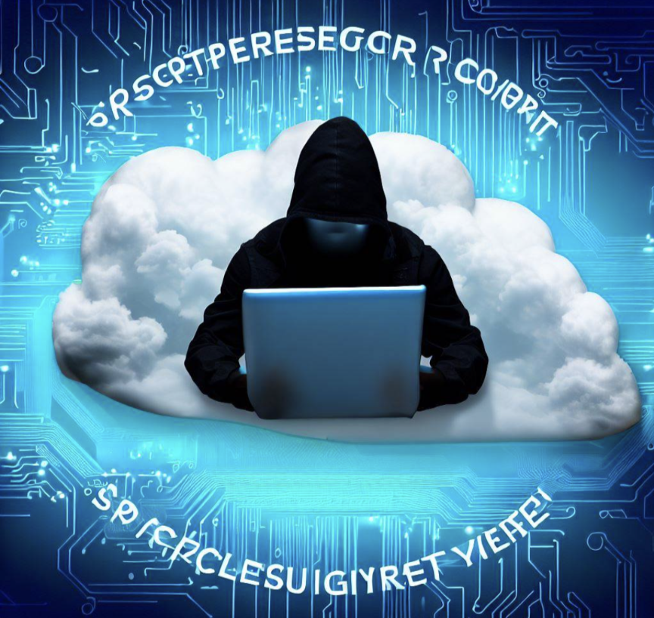



Top Cloud Security Issues, Threats and Concerns ( )
According to the Internet
Misconfiguration
Lack of Visibility
Malicious Insiders
Notes:
Misconfigurations of cloud security settings are a leading cause of cloud data breaches. Several factors contribute to this. Cloud infrastructure is designed to be easily usable and to enable easy data sharing, making it difficult for organizations to ensure that data is only accessible to authorized parties. Also, organizations using cloud-based infrastructure also do not have complete visibility and control over their infrastructure, meaning that they need to rely upon security controls provided by their cloud service provider (CSP) to configure and secure their cloud deployments.
An organization’s cloud-based resources are located outside of the corporate network and run on infrastructure that the company does not own. As a result, many traditional tools for achieving network visibility are not effective for cloud environments, and some organizations lack cloud-focused security tools. This can limit an organization’s ability to monitor their cloud-based resources and protect them against attack.
A malicious insider already has authorized access to an organization’s network and some of the sensitive resources that it contains. Attempts to gain this level of access are what reveals most attackers to their target, making it hard for an unprepared organization to detect a malicious insider.
March 2023 the PRA published CBEST thematic findings following cyber risk stress testing of external financial institutions. 3 of the 6 findings identified common issues in Identity and Access Management process, including over-privileged accounts, and data security.

Slide 3




Vince’s Three “i”s of Monitoring in the Cloud
Inventory
Intelligence
Insights
Notes:
Growing number of solutions
47 requirements, but here are 3 of the most important
Inventory
You can’t protect what you can’t see
Agent-based solutions do not guarantee 100% coverage
Created bespoke solution for unknown unknowns
Multi cloud only increases the issue
Should be moving away from traditional VM-based estate
Intelligence
New vulnerabilities have threat actors knocking on our doors
Time to exploit has reduced
Vulnerability data sources widely available, you can do it yourself
Insights
Risks without context are meaningless. Remember that.
CSPs highlight issues in isolation against policies
Is a missing OS patch on a VM that serious?
Following basic security principals provides layers of security
What if game .. Unpatched server … Elevation of Privilege … Pubic IP … poor SSH… lateral move?
Without context possible risk and impact may never be realised
Summary
47 requirements .. A few must haves

Slide 4

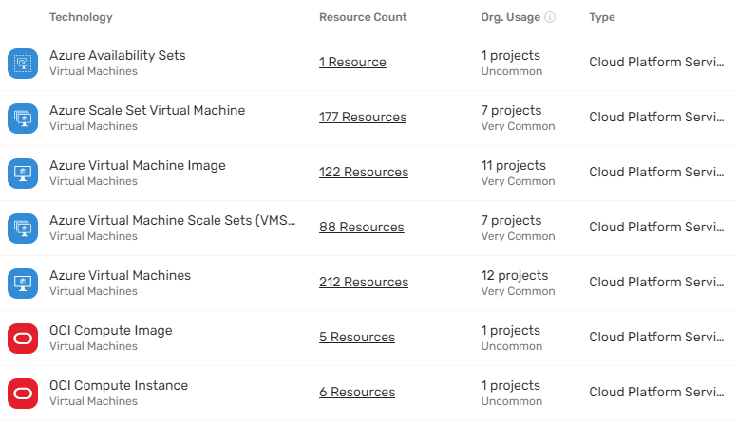
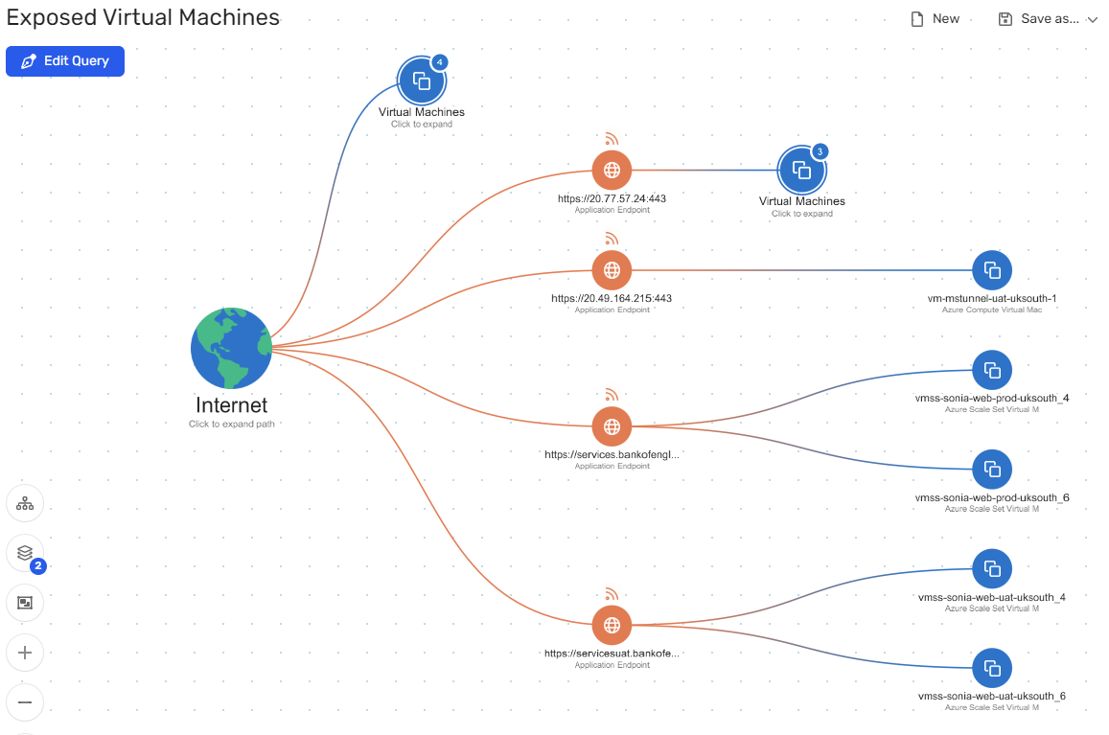
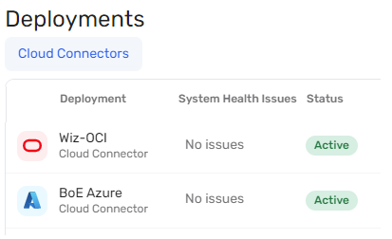
The Winning Solution
Inventory
Insights
Connectivity
Notes:
Connectivity
Wiz is agentless and required little configuration to be able to connect to the Bank’s “main” Azure tenant. As we all know, the Bank is a monogamous when it comes to Cloud Service Providers … or at least we were. When the situation arose that required the Bank’s use of OCI, Wiz gave us the ability to create a connection to this additional Cloud tenant.
Inventory
By connecting into the root of our Cloud tenants, Wiz has the ability to find all the skeletons in all the cupboards. Using Wiz we have been able to identify all the active, and more importantly the stale resources in our estate. We’ve also been able to dig into the posture of these resources, identify vulnerabilities and missing patches.
Intelligence
Wiz is able to source intelligence from a number of sources and, along with their own research, provide information on current and emerging threats.
Insights
With the data around our inventory overlaid with the intelligence it gathers, Wiz is able to provide insights into our areas of exposure and risk. This capability provides a triage for issues, helps prevent alert fatigue, and allows us to focus on the important problems. By using Wiz we are able to investigate issues and dig into resources, accounts, and connectivity as needed.

